Slide 1
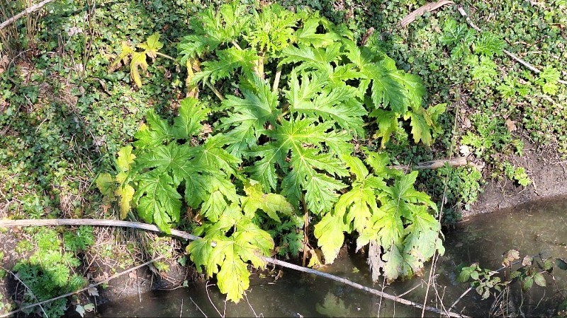
AI FOR GOOD · HACKATHON 7
Hogweed
Guard NL
A cautious Roboflow screening tool for Dutch nature volunteers
Max Lopez · SDG 15, Life on Land

Slide 2
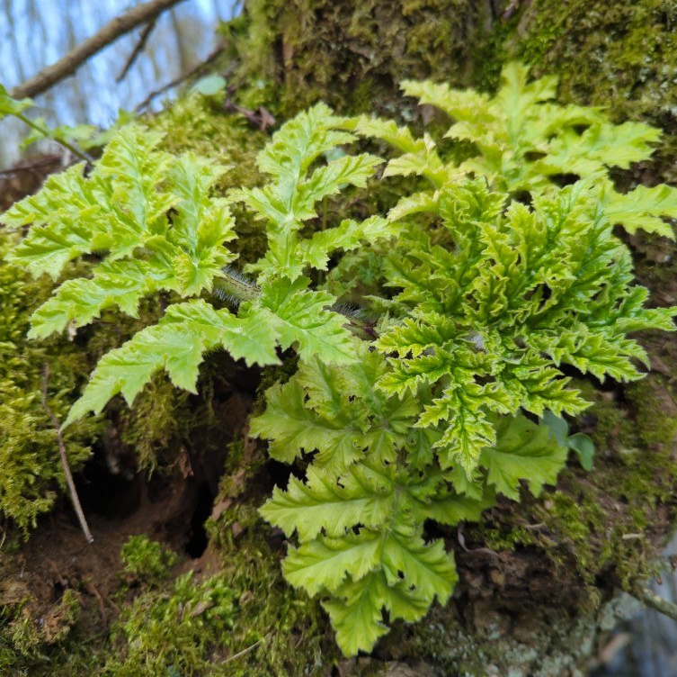
The identification problem
Giant hogweed is invasive in the Netherlands. Dense stands can displace native vegetation, while contact with its sap and sunlight can cause severe skin injury.
The Dutch NVWA warns that people can confuse it with native common hogweed. Intended users are nature volunteers and site managers — not people seeking medical advice or automatic removal decisions.
A wrong guess has two costs: native plants may be removed, or a person may approach a hazardous plant.
HOGWEED GUARD NL · 2/5

Slide 3
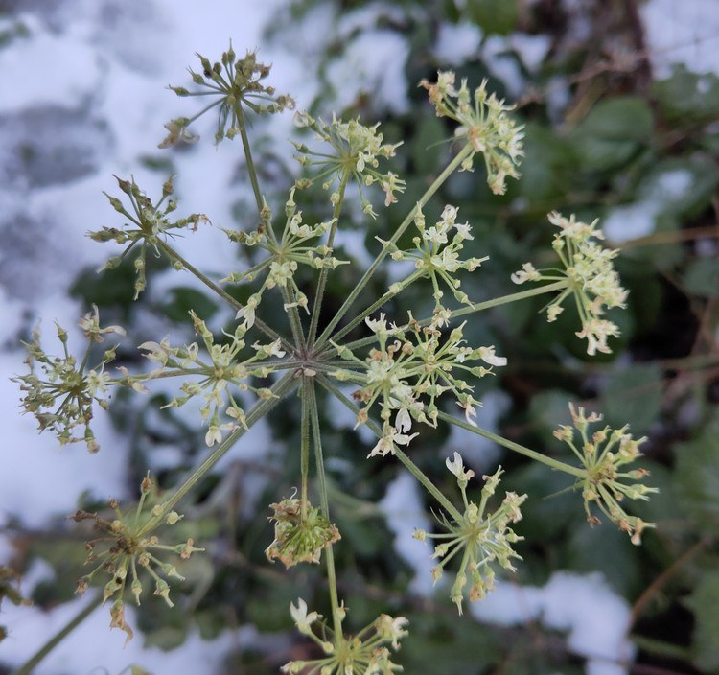
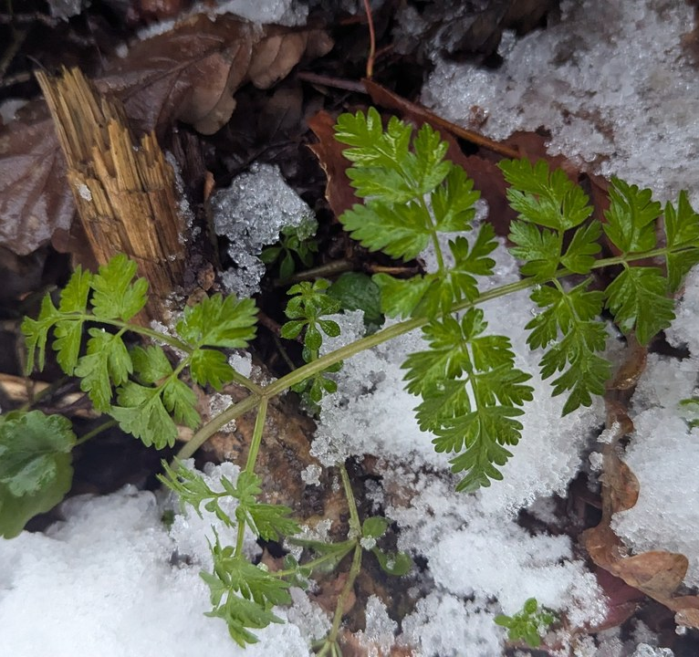
A Dutch, licence-tracked dataset
Giant hogweed
Common hogweed
Cow parsley
Heracleum mantegazzianum
Heracleum sphondylium
Anthriscus sylvestris
108 model images · 12 held out
108 model images · 12 held out
108 model images · 12 held out
360 Dutch GBIF observations · creator, licence and source URL preserved · no synthetic images
HOGWEED GUARD NL · 3/5

Slide 4
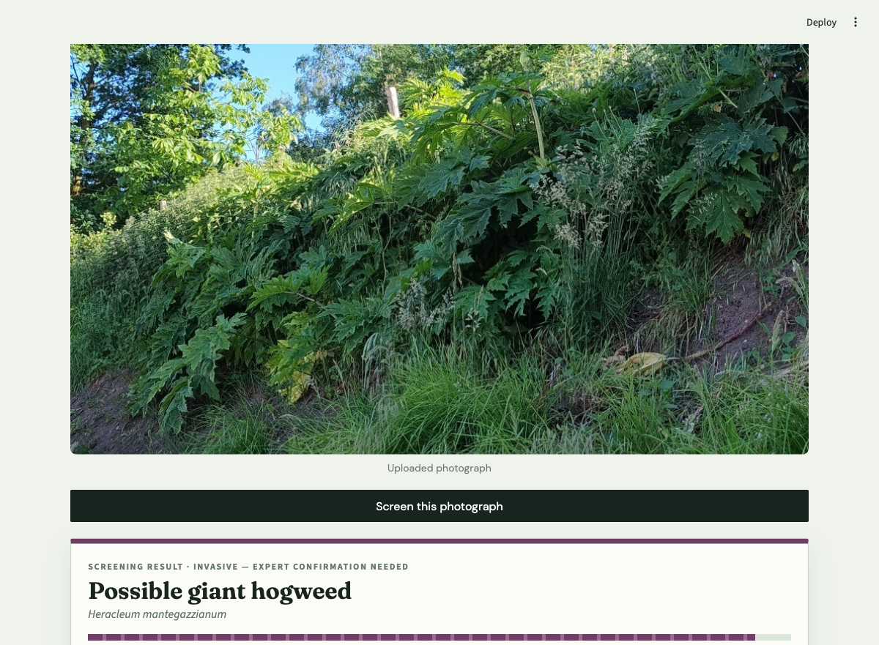
Photo to cautious screening result
1
Upload
A volunteer provides one clear plant photograph.
2
Classify
The Roboflow DINOv3 Small workflow compares three trained species.
3
Check confidence
The app withholds results below the safety threshold.
4
Act cautiously
The user keeps distance and requests expert confirmation.
Held-out example: giant hogweed at 95% confidence
Roboflow performs the essential visual classification. Without the trained model, the app cannot screen the photograph.
HOGWEED GUARD NL · 4/5

Slide 5
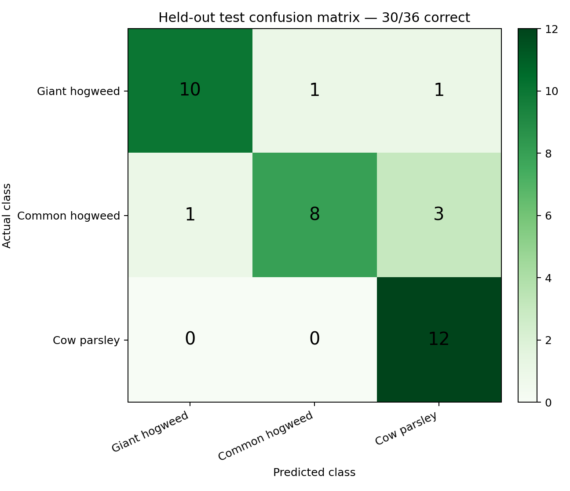
Independent test confirms the safety limits
HELD-OUT RESULT
30 / 36 correct
83.3% accuracy on images Roboflow never saw
Giant hogweed 10/12
Common hogweed 8/12
Cow parsley 12/12
SAFETY-RELEVANT ERRORS
One giant hogweed image was labelled common hogweed. One common hogweed image was labelled giant hogweed.
What I learned: held-out testing exposed important errors, so the app withholds scores below 65% and requires expert confirmation.
HOGWEED GUARD NL · 5/5

